Slide 1


Green Pace
Security Policy Presentation
Developer: Emmanuel Nieves

Slide 2

OVERVIEW: DEFENSE IN DEPTH
This Model illustrates a variety of methods used in Cyber Security to defend systems and data from intruders

Slide 3
THREATS MATRIX
Risk analysis
Severity
Probability | Low | Medium | High
Unlikely | STD-006-CPP | STD-001-CPP STD-008-CPP STD-009-CPP
Probable |  |  | STD-002-CPP
Likely | STD-007-CPP |  | STD-003-CPP STD-004-CPP STD-005-CPP STD-010-CPP

Slide 4
10 PRINCIPLES
Validate Input Data
Heed Compiler Warnings
Architect and design for Security Policies
Keep it Simple
Default Deny
Adhere to the Principle of Least Privilege
Sanitize Data sent to other Systems
Practice Defense in Depth
Use Effective Quality Assurance Techniques
Adopt a Secure Coding Standard

Slide 5
CODING STANDARDS
Rule | Severity | Likelihood | Remediation Cost | Priority | Level
STD-001-CPP | Medium | Unlikely | Medium | P4 | L3
STD-002-CPP | High | Probable | High | P6 | L2
STD-003-CPP | High | Likely | Medium | P18 | L1
STD-004-CPP | High | Likely | Medium | P18 | L1
STD-005-CPP | High | Likely | Medium | P18 | L1
STD-006-CPP | Low | Unlikely | High | P1 | L3
STD-007-CPP | Low | Likely | Low | P9 | L2
STD-008-CPP | Medium | Unlikely | Medium | P4 | L3
STD-009-CPP | Medium | Unlikely | Low | P6 | L2
STD-010-CPP | High | Likely | Medium | P18 | L1

Slide 6
ENCRYPTION POLICIES
Encryption in rest - Protects stored data.
Hard drives, phones, computers, cloud assets, etc.
Encryption at flight - Protecting data that is moving.
Devices within a network or moving outside of a network.
Encryption in use - Protects data that is created, edited, or otherwise defined as in-use.
Ensuring protection is in place prior to use.

Slide 7
TRIPLE-A POLICIES
Authentication - The act of confirming one’s identity.
Ensure a person is who they claim to be.
Authorization - Specifies the access rights and privileges of a user and are an important part of information and computer security.
What a user can and cannot access
Accounting - The process of keeping track of activity while interacting with a system, showing timestamps, accessed resources, and data transfer information.
Bread crumb trail of activity.

Slide 8
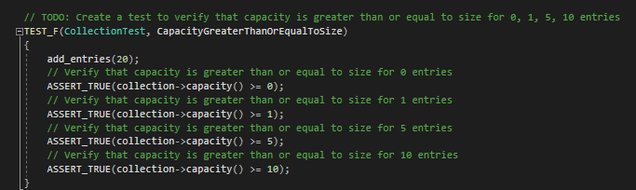

Unit Testing
Unit testing – Verify and validate components of a program or application, in order to ensure the app will act and respond as intended.
Testing done with Google Test (gtest):
https://github.com/google/googletest/
Test to verify if entries is greater than or equal to size.

Slide 9

AUTOMATION SUMMARY

Slide 10
TOOLS
What is DevSecOps?
CPPCheck: static code analysis (https://cppcheck.sourceforge.io/)
Clang: front-end compiler (https://clang.llvm.org/)
Parasoft: automated testing suite (https://www.parasoft.com/)

Slide 11
RISKS AND BENEFITS
Risk of waiting:
Harm to data
Harm to customer trust
Financial cost
Potential future damages of multiple attacks
Benefits of planning:
Mitigating possible damage
Prevent threats
structure and procedure
Reduce possible testing overhead
Example case:
Equifax Breach
Date of case:
March 2017
Result:
Over 143 million users impacted by the data breach, as well as a financial compensation as part of a settlement

Slide 12
RECOMMENDATIONS
Security Policy Essentials:
Policy is a solid foundation. Should be subject to regular reviews and updates, or as gaps are identified.
Annual checks from an outside source, such as a white hat security firm, will help to give security a real-world test and find possible vulnerabilities.
Early application of these policies will help to ensure security is consistently at the forefront of progress.

Slide 13
CONCLUSIONS
Adopting best practices and coding standards, defense in depth, and constant consideration to motives that may result in potential attacks attitude towards cyber security throughout development will help Green pace with any future endeavors.

Slide 14
REFERENCES
Sei External Wiki Home. SEI External Wiki Home - Homepage - Confluence. (n.d.). Retrieved April 19, 2023, from https://wiki.sei.cmu.edu/confluence/

